Slide 1


FOR CLUB ADMINISTRATORS
At Indiana Soccer, we believe in the power of goals—on and off the field.
Every day, we strive to serve our members with excellence, and that includes our dedicated Club Administrators. This forum is designed to be a space where we provide best in class content, share, listen, and grow together. Whether you're setting new goals or working toward existing ones, we're here to support you in your role and help you succeed within your organization.
Let’s build stronger clubs together.

Slide 2



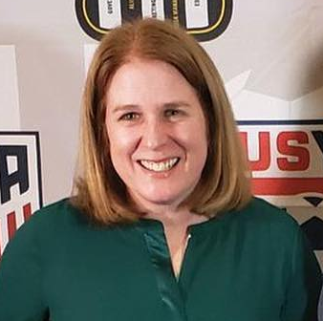
Merging without a turn signal
Wednesday, September 30, 2026 12:30 PM ET
Presented by:
Angel hall
associate director
Georgi emenhiser
operations & ODP Administrator
Mary schalliol
Member Registration & topsoccer liaison

Slide 3


What is a database?
Think about a traditional office:
A filing cabinet holds information. (Think INDIANA SOCCER )
Each drawer contains a category of information. (Think YOUR CLUB)
Each folder contains records. (Think your TEAMS)
Each document contains details about a person, item, or event. (Think PEOPLE)

Slide 4

Imagine that file cabinet is a mess!
Multiple records for the same person.
Records filed incorrectly.
Records missing important information.
Records with wrong information.

Slide 5

What can happen if the filing cabinet is messy?
Players can end up registered with two different clubs at the same time.
Players can not be registered because information is missing/incorrect.
Coaches cannot be cleared timely for participation because data in Gotsport does not match data submitted on background check, Safesport, etc.

Slide 6

How do I fix the club's database?
Use legal names for everyone.
Scrub the data to see what needs fixed and fix it.
Use the MERGE tool provided in the Gotsport platform to remove all the duplicate records the system can identify.

Slide 7
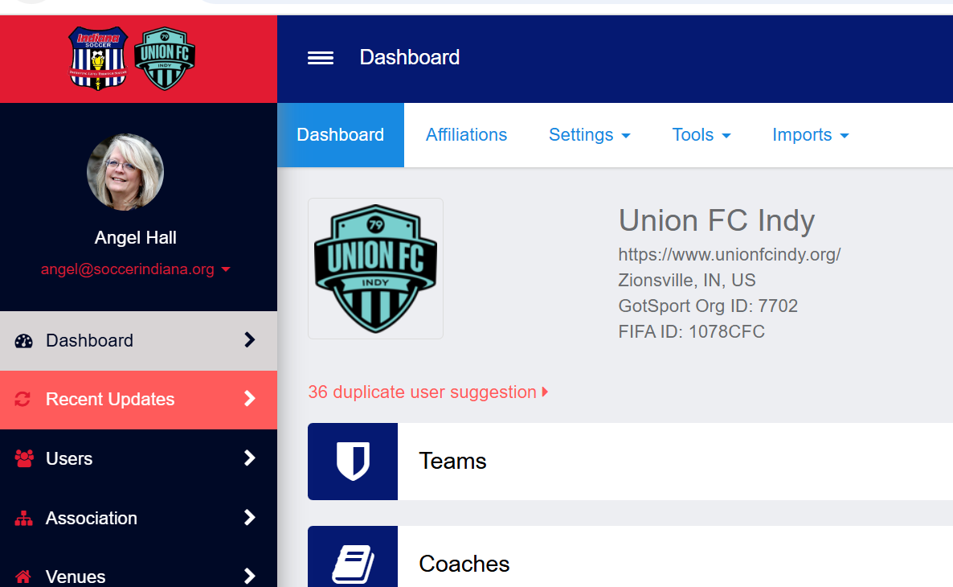
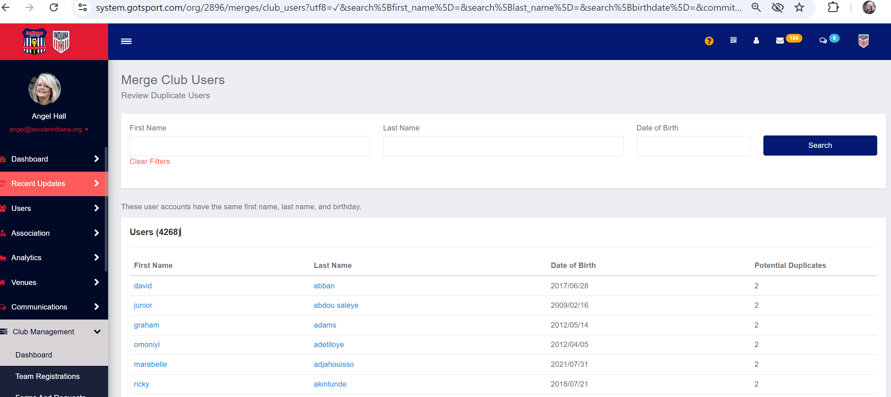
How to locate duplicate records
These are records that GOTSPORT can identify as duplicates.*
1
2
3
*Records with the same first name, last name and birthdate.

Slide 8

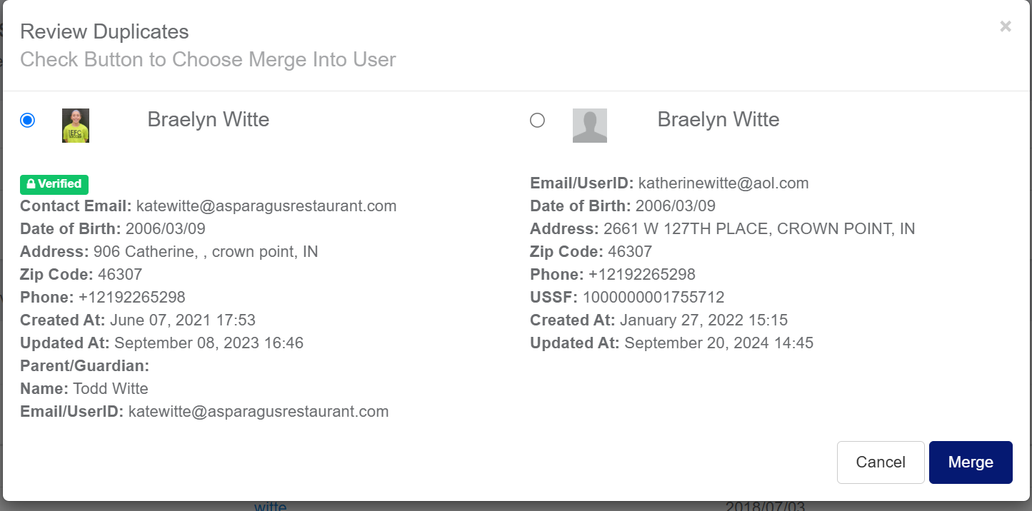
How to merge duplicate records
2
1
3

Slide 9

What if a person leaves our club?
ARCHIVE the record/role with your club so you have access later should the need arise.
DELETE the role if you are completely severing ties with that individual.
NOTE – remove the person from all connected teams BEFORE deleting or archiving the role.

Slide 10
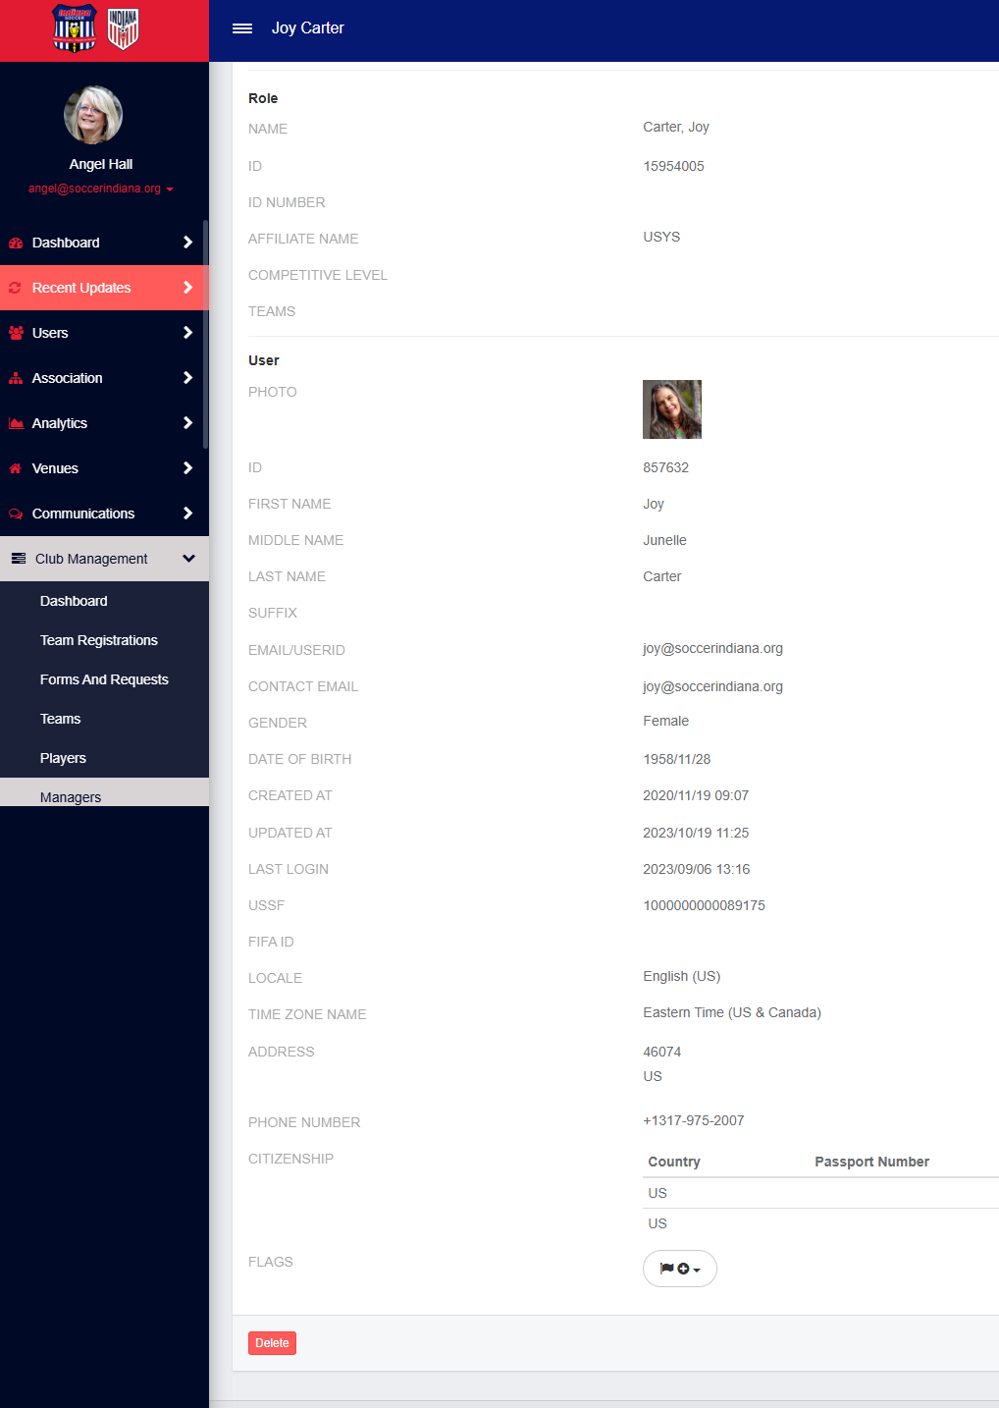
Notes about "delete"
in gotsport
As it relates to people records only, the word DELETE means DETACH. You will not be "deleting" the person from Gotsport, you are only deleting their ROLE with your club.

Slide 11

how bad is it?
As of Sept 30, 2026 – Indiana Soccer can identify 4,268 duplicate people records in Gotsport.
That does not include the number of duplicate records for people with datapoints so different that Gotsport can't identify them as the same person.

Slide 12

need help?
Indiana Soccer is happy to assist help you!
If you would like help cleaning your people databases, just let us know! We can:
Remove duplicate player, coach, and manager records.
Remove duplicate player, coach, and manager roles.
Archive non-active players, coaches, managers.
"Delete" the roles (remove from your club) players, coaches, and managers you no longer want/need attached.

Slide 13

Questions on the topic of
Data cleaning & merging records

Slide 14
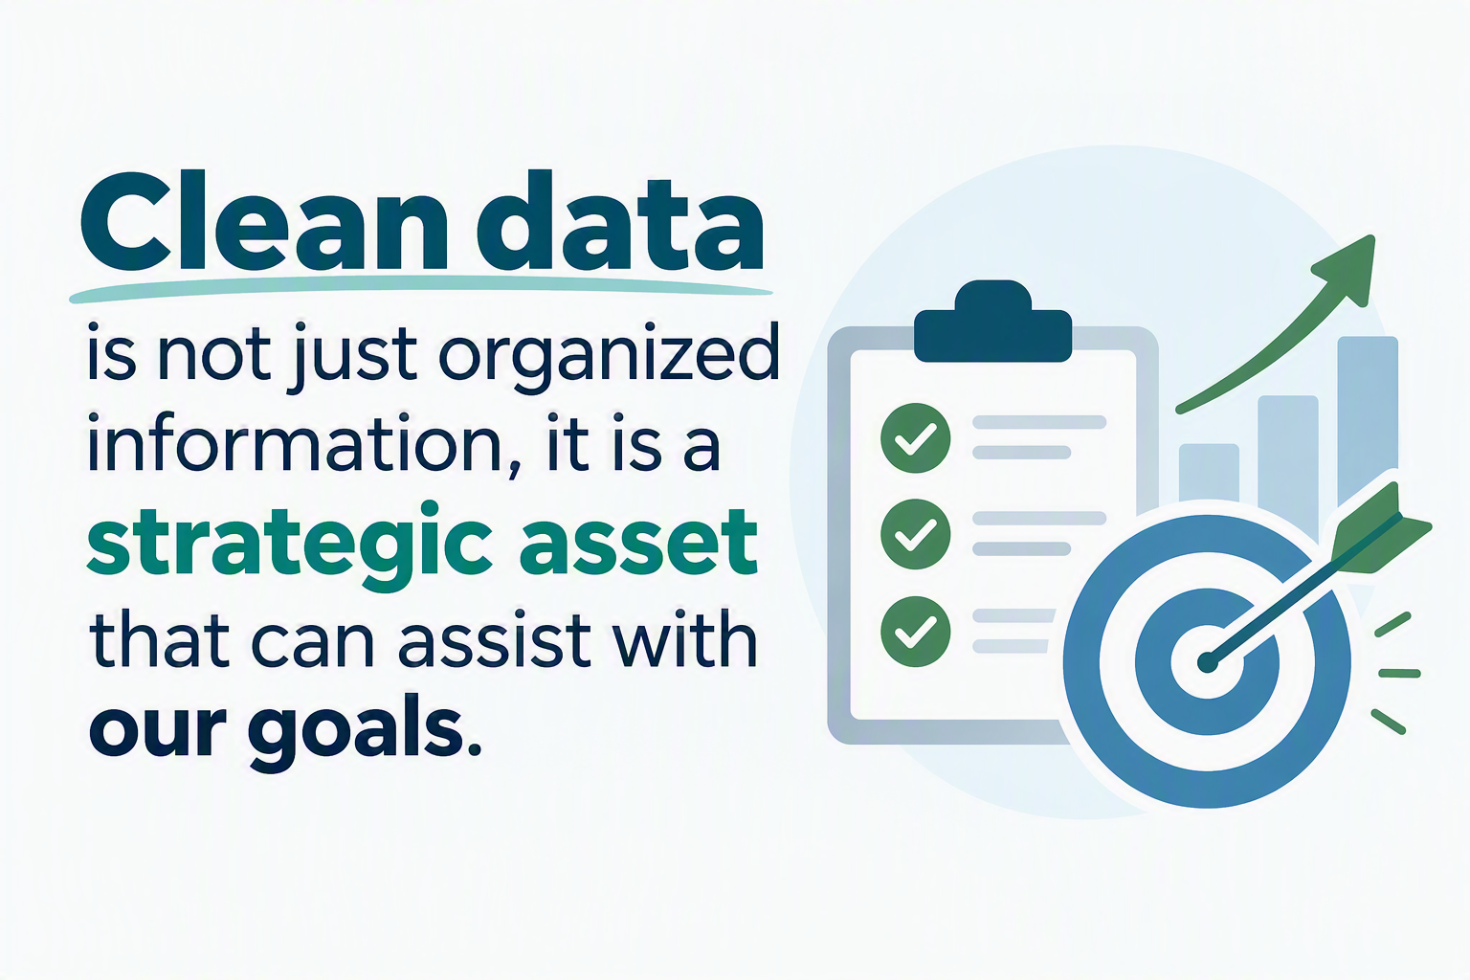
This week's ​
goal getter​
mindful minute:​

Slide 15
Upcoming forums
Wednesday, October 21, 2026 12:30 PM ET
Topic: One Year Anniversary of Goal Getters
If you have a topic you would like us to cover, drop one of us an email!

Slide 16
We can stay longer,
How can we help you?

